Slide 1
The Sphere of Life:
Discovering Earth
- by team Excelsior

Slide 2
How does our planet work?
We identified several problems:
- Mosquitoes borne diseases cause millions of deaths anually
- Deforestation is accelerating, despite mounting efforts against it
- Slow rate of adoption of solar energy due to economic factors
- Inefficient farming practices lead to low yield and resource wastage
What is one common factor in all these problems you ask?

Slide 3

Data!

Slide 4
How does our planet work?
Large amount and variety of data collected by
NASA, which can be used to drive forward large
impact efforts, is difficult to be understood by
people.

Slide 5
1. Better Details, Intricate Visualizations!
Look, Ma! I understand it!

Slide 6
2. Analysis of data to create innovative solutions using machine learning.

Slide 7
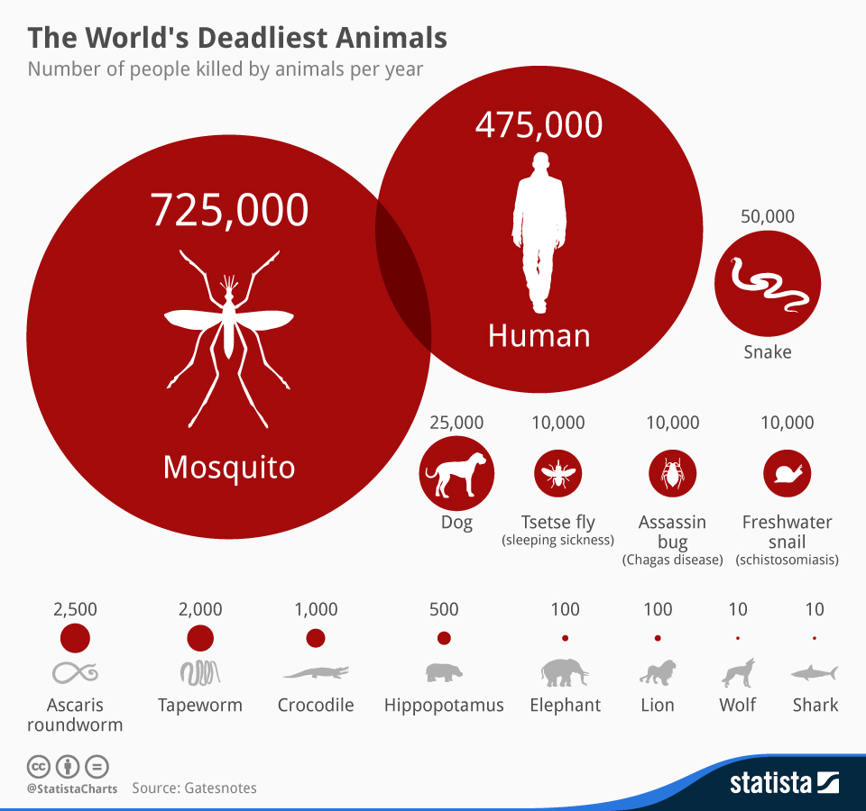
HEALTH AND OUR EARTH
Problem:
Solution:
Analysed NASA dataset to map mosquitoes prone habitats.
Predicted probability of spread of disease across the world to help prevent epidemic.

Slide 8
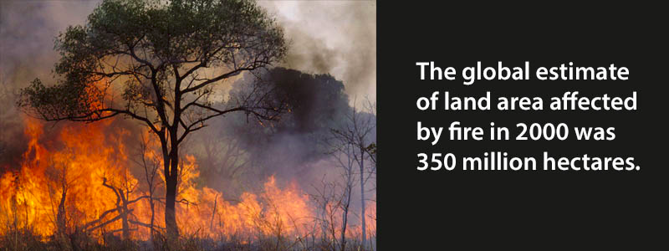
The Trees and Earth
Problem:
Solution:
Identified forest fires as a major cause of vegetation loss
Analysed regions affected the most by forest fires
Predicted forest fires in areas using deep learning

Slide 9

The Future is Renewable
Problem: To encourage solar energy adoption and determine its utilisation potential across the world
Solution:
Analysed the potential economic feasibility of solar energy across the world
Designed a system based on AI to recommend solar infrastructure

Slide 10

The Food We Eat
Problem: Unawareness about food crops and their economic feasible regions across the world
Solution:
Analysed and identified regions having maximum yield potential
Identified factors for maximum crop yield
Predicted profit associated with their regions respectively

Slide 11
Added Bonus: Hello Prakriti!
Prakriti is a personalized chatbot, our very own representative of mother nature!
She is a self-enhancing personal assistant which provides a brief insight of entire platform, making the user experience more interactive!

Slide 12
Learn by Observing, not by Reading
Easy to understand Visualization of Cloudy patterns, snow patterns and rainfall precipitation measure
Identifying interesting patterns using manual coordinates
Multiple Views of Earth surface in all possible projections such as 1D,2D and 3D views

Slide 13
THANK YOU!
Any questions?
Team Excelsior
@cse_as

